Slide 1
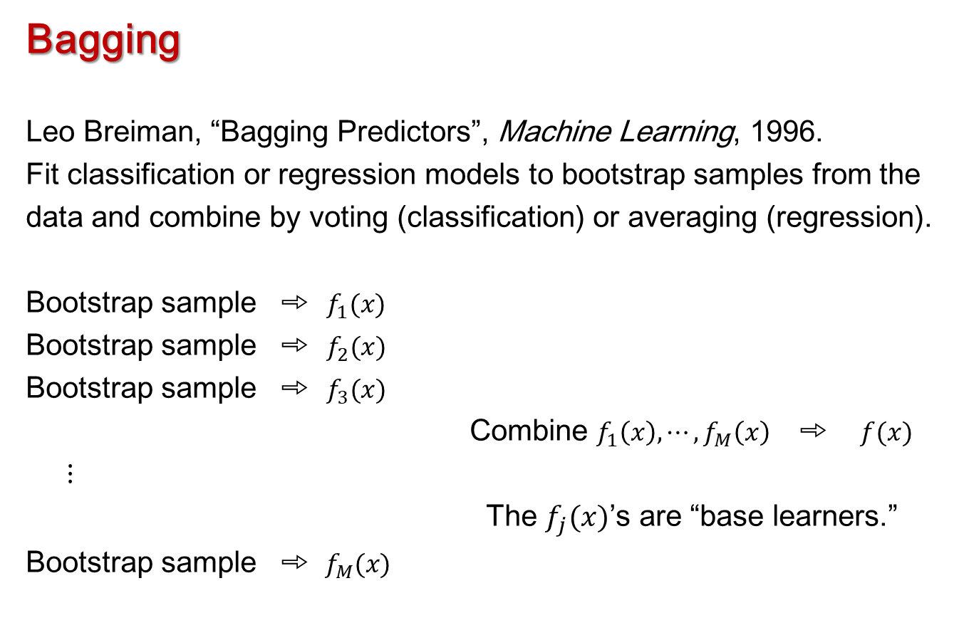
Tree-based Methods for Classification & Regression
Bagging
Leo Breiman, “Bagging Predictors”, Machine Learning, 1996.
Fit classification or regression models to bootstrap samples from the
data and combine by voting (classification) or averaging (regression).
Bootstrap sample ➾$f_{1}(x)$
Bootstrap sample ➾$f_{2}(x)$
Bootstrap sample ➾$f_{3}(x)$
Combine $f_{1}\left(x\right), ⋯, f_{M}\left(x\right)$➾ $f(x)$
$⋮$
The $f_{j}(x)$’s are “base learners.”
Bootstrap sample ➾ $f_{M}(x)$
Notes:
This material is covered in section 8.2.1 in the textbook, starting on Page 316.
The paper by Breiman has over 23,000 citations in Google Scholar. It is a seminal paper in machine learning.
In the mid 1990’s so called “ensemble methods” for classification and regression were popular. These are methods in which the predictions from multiple regression or classification models are combined to give more accurate predictions. Bagging was Breiman’s first approach to ensemble methods, and it grew out of the observation that classification trees were unstable in the sense that small perturbations of the data could lead to very different fitted trees.
The basic idea is to draw a lot of random samples from the data and to apply a regression or classification method to each sample, and then to combine the predictions from all the fitted regression or classification functions in a meaningful way, to improve predictive accuracy.

Slide 2
Tree-based Methods for Classification & Regression
Bagging (Bootstrap Aggregating)
A bootstrap sample is chosen at random with replacement from the data. Some observations end up in the bootstrap sample more than once, while others are not included (“out of bag”).
A classifier or regression function is fitted to each sample.
Predictions are made for the out-of-bag observations and combined by averaging (regression) or voting (classification).
Bagging reduces the variance of the base learner but has limited effect on the bias.
It’s most effective if we use strong base learners that have very little bias but high variance (unstable). E.g. trees.
Notes:
Bullet 1: We will talk about bootstrap samples in more details shortly. For the moment, just assume that they are random samples of some kind from the original data.
Bullet 2: This section of work is about tree-based methods but Bagging is a very general algorithm that may be applied to many different methods, such as nearest neighbor classifiers.
Bullet 5: In order to achieve gains in accuracy the base learner has to be unstable, such as a large or very small tree. For linear discriminant analysis (LDA), bagging does not improve the predictive accuracy.

Slide 3
Tree-based Methods for Classification & Regression
Example: Lichen air quality data, pilot evaluation data (crossvalidated) for pruned tree and bagging
Method | PCC | Specificity | Sensitivity | K | AUC
Pruned tree | 77.3 (82.7) | 80.5 (92.2) | 68.8 (49.7) | .459 (.457) | .764 (.780)
Large Tree | 76.0 (79.1) | 79.1 (86.5) | 67.5 (52.9) | .432 (.395) | .733 (.697)
Bagging100 | 82.7 (83.0) | 89.1 (91.6) | 65.0 (52.9) | .550 (.475) | .770 (.723)
Bagging500 | 83.0 (83.6) | 87.3 (92.2) | 71.3 (53.5) | .574 (.490) | .793 (.728)
Notes:
I applied bagging to the Lichen Air Quality data (LAQI) using fully grown trees as base learners, and evaluated the accuracy of the predictions by cross-validation and by predicting onto the Pilot Random Grid data (pilotI), as we have done with other classifiers.
The 100 and 500 refer to the number of random samples of the data drawn.
You can see that the overall predictive accuracy on the Pilot data for the bagged trees is about 5% to 6% higher than for the individual trees.
You can also see that the predictive accuracies estimated by cross-validation and on the Pilot data are very similar (so cross-validation is a good estimate of true prediction error).

Slide 4
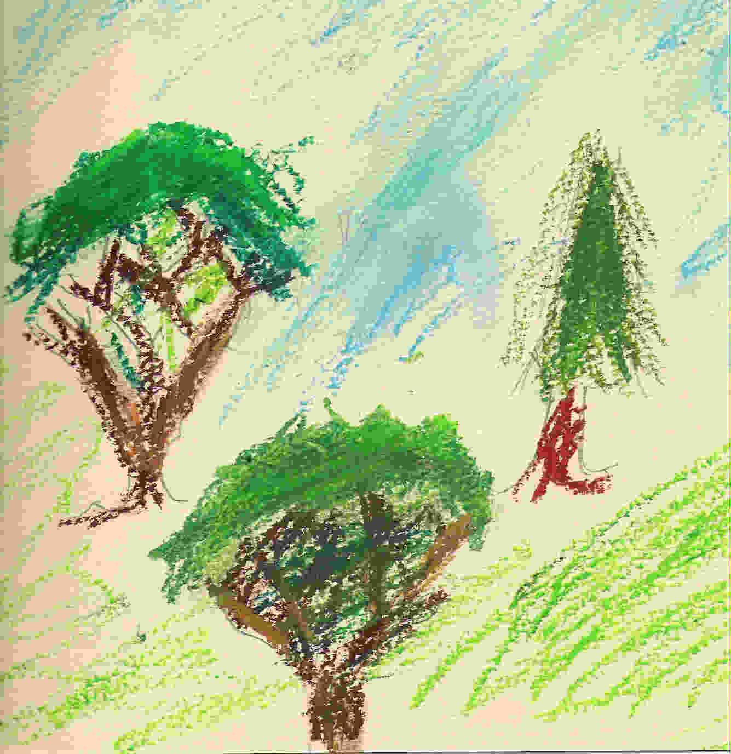
Leo Breiman, UC Berkeley Adele Cutler, Utah State University
Tree-based Methods for Classification & Regression
Random Forests
Notes:
Random Forests is a very special form of bagging that uses trees as base learners and imposes restrictions on how the trees are grown on the randomly samples of the data.
The paper “Random Forests” appeared in the journal Machine Learning in 2001 and now has over 55,000 citations in Google Scholar.
Professor Adele Cutler began working on Random Forests with Professor Breiman between the submission and appearance of the paper and since Professor Breiman’s passing she has been the foremost expert on Random Forests.
This material is covered in the textbook in section 8.2.2 starting on page 319 but you should read the section on bagging (8.2.1) first.

Slide 5
Tree-based Methods for Classification & Regression
Random Forests Software
Free, open-source code (FORTRAN, java)
www.math.usu.edu/~adele/forests
Salford Systems (Now part of Minitab)
www.salford-systems.com
R interface, independent development (Andy Liaw and Matthew Wiener)
SAS: PROC HPFOREST
Python
Notes:
The FORTAN and Java implementations are the fastest if processing time is of the essence, but they require some work to get the data into the correct format.
The Salford Systems version of Random Forests is the “glitziest” with a nice GUI.
The R version of Random Forests, based on an earlier version of Breiman’s and Cutler’s FORTRAN code is BY FAR the most used version. Every week there are many thousands of downloads of the package in R.
The SAS and Python versions of Random Forests diverge from the original algorithm in subtle ways but seem to have the same accuracy, on average.

Slide 6
Tree-based Methods for Classification & Regression
Random Forests
General-purpose tool for classification and regression.
Very high accuracy - about as accurate as gradient boosting machines and support vector machines for classification.
Capable of handling large datasets.
Fully non-parametric—there are no distributional assumptions.
Effectively handles complex, non-linear interactions among predictors.
Effectively handles missing values.
For most applications, requires no tuning. That is, Random Forests can be used “off the shelf.”
Notes:
Bullet 4: These is no distributional assumption for the response variable in regression but it is prudent to eliminate extreme skewness and outliers using a transformation such as a log. As with trees, no transformations of the predictor variables are needed, even if they are very skewed and have extreme outliers.
Bullet 7: Being able to use it “off the shelf” without difficult and tedious tuning of parameters is a feature of Random Forests that makes it very popular with practitioners in statistics and application areas, including business.

Slide 7
Tree-based Methods for Classification & Regression
In addition to classification and regression, Random Forests may be used for:
Missing data imputation.
Unsupervised learning (cluster analysis).
Survival analysis without making the proportional hazards assumption.
Data visualization.
One variable and two variable partial dependence plots to evaluate the associations between predictors and response variables.
Multidimensional scaling plot to visualize proximities among observations
Notes:
Bullet 1: I used Random Forests to impute a small number of missing values in each of the Lichen Air Quality and Pilot Random Grid datasets.
Bullet 3: The Cox Proportional Hazards Model has been the mainstay of survival analysis since the 1970’s but there is a growing body of evidence that Survival Forests outperforms the Cox Model even in situations where the proportional hazard’s assumption is true.
Bullet 4: For “black box” methods like Random Forests, visualizations are very important for the interpretation of the fitted classification or regression. The best graphics for Random Forests are available in the R implementation. Partial dependence plots were originally developed by Jerry Friedman for is gradient boosting algorithms but are applicable to many black box methods including Random Forests, boosted trees, and support vector machines.

Slide 8
Tree-based Methods for Classification & Regression
Random Forests
Two key building blocks for Random Forests are:
Classification and regression trees.
Bootstrap samples. A bootstrap sample is a sample of the same size as the original dataset drawn from the original dataset with replacement.
Each observation in the original dataset can occur in the bootstrap sample 0, 1, 2, 3, or more times.
In a typical bootstrap sample, 63% of the original data points occur one or more times.
In a typical bootstrap sample 37% of the original data points do not occur and are said to be out-of-bag with respect to the bootstrap sample.
Notes:
Item 2: Bootstrapping was originally developed by Brad Effron in the 1970’s and has become very much a part of the statistics mainstream. It is widely used for non-parametric estimation of confidence intervals and P-values for tests.
Item 2: In Homework #4 I ask you to derive the 63%/37% numbers.

Slide 9
Tree-based Methods for Classification & Regression
Random Forests Algorithm
Many (in R the default is 500; in SAS it is 100) bootstrap samples are drawn from the data.
To each bootstrap sample a classification or regression tree is fit with the restriction that, at each node, only a random sample of variables is available to be split on.
For regression, the default is one third of the number of predictor variables.
For classification, the default is the square root of the number of predictor variables.
The trees are fully grown. That is, no pruning of the fitted trees takes place.
Notes:
Item 1: When he was developing Random Forests, Breiman typically used 25—50 trees. It turns out that the predictive accuracy does not increase much, if at all, with more trees beyond about 50 in most problems.
Item 2: The restriction to only a small number of variables at each node ensures that the trees are “different,” which is very important to achieve gains in classification accuracy.
Item 3: Usually fully grown trees overfit the data but in this application it helps by making the trees be unstable.

Slide 10
Tree-based Methods for Classification & Regression
Random Forests Algorithm
For each observation, a predicted value or class is obtained for every tree/bootstrap sample for which the tree is out-of-bag.
That’s 37% of the bootstrap samples, on average, so about 185 of the default 500 trees.
The out-of-bag predictions from the trees are combined to give a single prediction.
In regression the out-of-bag predictions are averaged.
In classification, the out-of-bag predictions are voted. For example, if 40 of the predictions are class A, 87 are class B, 32 are class C, and 26 are class D, then the predicted class is B.
In classification, the proportions of predicted values in each class are the predicted probabilities for the respective classes.
Notes:
Item 5: In Python for classification the probabilities of the different classes are averaged and the predicted class is the one with the largest averaged predicted probability. In some cases this improved the accuracy, in other cases it makes it worse, but the differences are very small.

Slide 11
Tree-based Methods for Classification & Regression
Random Forests Proximities
For each pair of observations we define the proximity between two points to be the proportion of trees that the observations end up in the same terminal node of. We can calculate proximities in two ways:
The default is to only use the trees for which both observations are out-of-bag.
One can also compute proximities by passing the pairs of observations down all the fitted trees.
Proximities may be used for:
Clustering observations. Distance = 1 – proximity.
Imputation of missing values.
Graphical representations of similarity of observations.

Slide 12
Tree-based Methods for Classification & Regression
Random Forests Variable Importance
Each observation has a predicted value (numerical for regression; a class for classification) for each tree for which it is out of bag.
For the trees for which the observation is out-of-bag, randomly permute the values of the predictor variable of interest and pass the observations down the tree to get new predictions.
The change in the prediction error (for regression) or the misclassification rate (for classification) is a measure of the importance of the variable for that observation.
The changes in prediction error or misclassification rate are averaged over all the observations and may be standardized by dividing by the standard deviation of those changes.

Slide 13
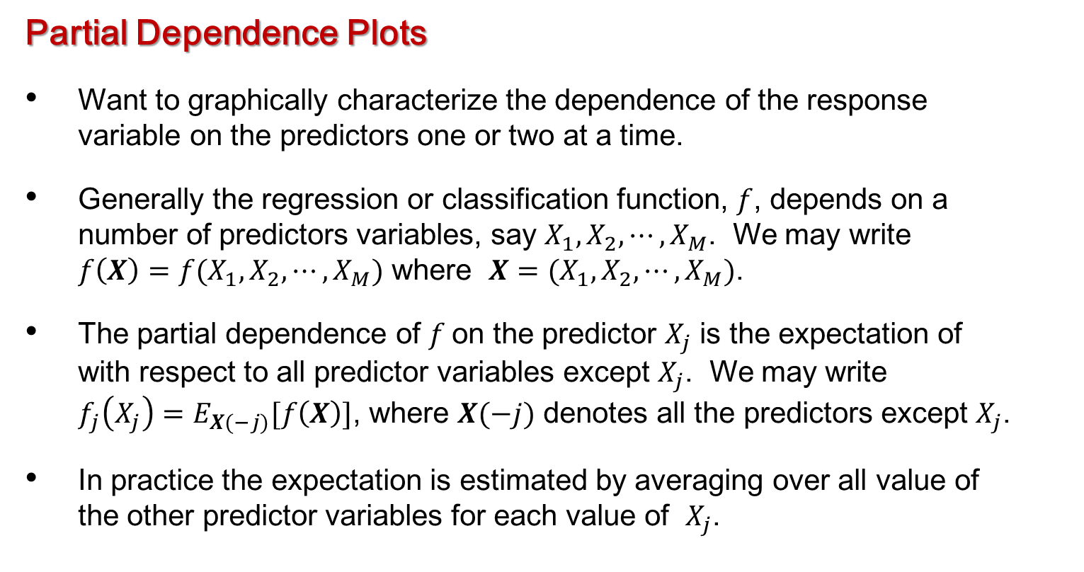
Tree-based Methods for Classification & Regression
Partial Dependence Plots
Want to graphically characterize the dependence of the response variable on the predictors one or two at a time.
Generally the regression or classification function, $f$, depends on a number of predictors variables, say $X_{1}, X_{2}, ⋯, X_{M}$. We may write $f\left(X\right)=f(X_{1},X_{2}, ⋯,X_{M})$ where $X=(X_{1}, X_{2}, ⋯, X_{M})$.
The partial dependence of $f$on the predictor $X_{j}$ is the expectation of with respect to all predictor variables except $X_{j}$. We may write $f_{j}\left(X_{j}\right)=E_{X(−j)}[f\left(X\right)]$, where $X(−j)$ denotes all the predictors except $X_{j}$.
In practice the expectation is estimated by averaging over all value of the other predictor variables for each value of $X_{j}$.

Slide 14
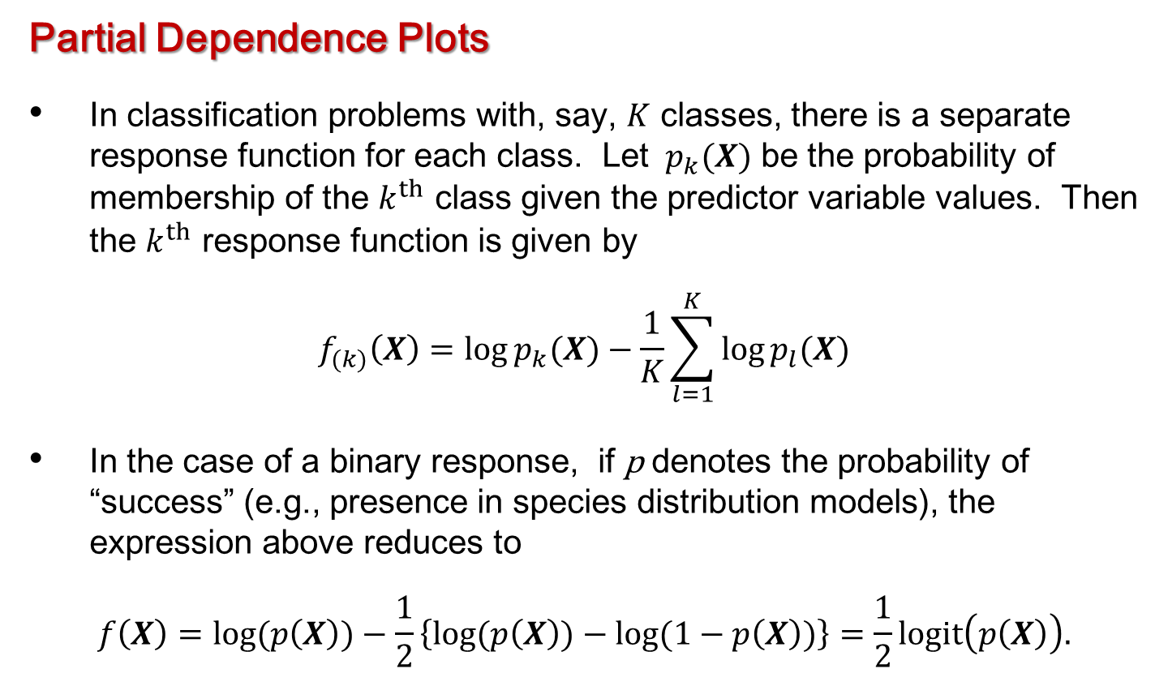
Tree-based Methods for Classification & Regression
Partial Dependence Plots
In classification problems with, say, $K$ classes, there is a separate response function for each class. Let ${ p}_{k}(X)$ be the probability of membership of the $k^{th}$ class given the predictor variable values. Then the $k^{th}$ response function is given by
$$f_{(k)}\left(X\right)=\log{p_{k}(X)}−\frac{1}{K}\sum_{l=1}^{K}{\log{p_{l}(X)}}$$
In the case of a binary response, if p denotes the probability of “success” (e.g., presence in species distribution models), the expression above reduces to
$$f\left(X\right)=\log{(p\left(X\right))}−\frac{1}{2}\left\{\log{(p\left(X\right))}−\log{(1−p\left(X\right))}\right\}=\frac{1}{2}logit\left(p\left(X\right)\right).$$

Slide 15

Tree-based Methods for Classification & Regression
Example: Cavity nesting birds, Random Forests, out-of-bag accuracies
$$PCC=84.98\%$$
$$Specificity=85.85\%$$
$$Sensitivity=84.11\%$$
$$κ=0.6996$$
$$AUC=0.9079$$
Actual Class | Predicted Class |  | Total
 | Absence | Presence
 | 0 | 1
Absence, 0 | 91 | 15 | 106
Presence, 1 | 17 | 90 | 107
Total | 108 | 105 | 213
Notes:
The R code for the analysis that follow may be found in the file ‘R code for RF for lichens SNRA and nest data.txt’
Throughout the analyses in the file I have used default settings for the Random Forests parameters such as the number of trees to fit and the number of variables available at each node to split on.
The package in R for fitting Random Forests (which you will have to download) is called randomForest
For Random Forests the true resubstitution accuracy is usually 100% or very close to it. Instead, we use the out-of-bag estimates of accuracy, which are very similar to cross-validation.

Slide 16

Tree-based Methods for Classification & Regression
Example: Cavity nesting birds, pruned tree, resubsitution accuracies
$$PCC=86.38\%$$
$$Specificity=85.85\%$$
$$Sensitivity=86.92\%$$
$$κ=0.7277$$
$$AUC=0.8876$$
Actual Class | Predicted Class |  | Total
 | Absence | Presence
 | 0 | 1
Absence, 0 | 91 | 15 | 106
Presence, 1 | 14 | 93 | 107
Total | 105 | 108 | 213

Slide 17

Tree-based Methods for Classification & Regression
Example: Cavity nesting birds, Random Forests, crossvalidation accuracies
$$PCC=85.45\%$$
$$Specificity=86.79\%$$
$$Sensitivity=84.11\%$$
$$κ=0.7090$$
$$AUC=0.9026$$
Actual Class | Predicted Class |  | Total
 | Absence | Presence
 | 0 | 1
Absence, 0 | 92 | 14 | 106
Presence, 1 | 17 | 90 | 107
Total | 109 | 104 | 213

Slide 18

Tree-based Methods for Classification & Regression
Example: Cavity nesting birds, pruned tree, crossvalidated accuracies
$$PCC=83.10\%$$
$$Specificity=81.13\%$$
$$Sensitivity=85.05\%$$
$$κ=0.6619$$
$$AUC=0.8378$$
Actual Class | Predicted Class |  | Total
 | Absence | Presence
 | 0 | 1
Absence, 0 | 86 | 20 | 106
Presence, 1 | 16 | 91 | 107
Total | 102 | 111 | 213
Notes:
The cross-validated accuracy estimate for Random Forests is a little (2% or so) higher than for a single pruned tree, but not much better.
But there is much more that we get from Random Forests.

Slide 19
Tree-based Methods for Classification & Regression
Example: Cavity nesting birds, Random Forests, variable importance.
Notes:
The plot that we are interested in is the left hand panel, the Mean Decrease in Accuracy.
Note that, for this dataset, the three most important variables are: NumTree3to6in, NumTree9to15in, and NumTree1to3in.

Slide 20
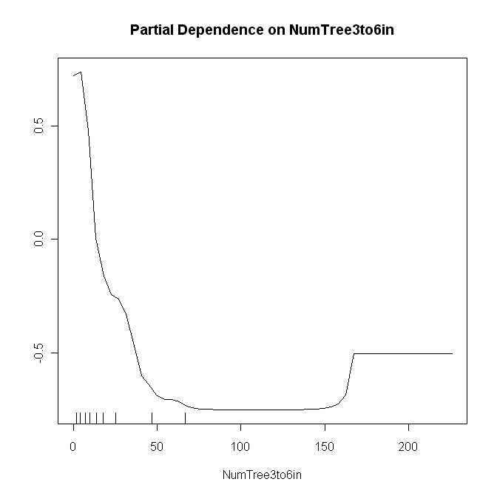
Tree-based Methods for Classification & Regression
Example: Cavity nesting birds, Random Forests, partial dependence plot for NumTree3to6in.
Notes:
This plot shows the relationship between NumTree3to6in and the logit of the probability of finding a nest. It is quite negative (and non-linear). That is, the probability of finding a nest decreases with increasing numbers of trees in this size class. The ‘whiskers’ on the plot are deciles, so there are very few sites with more than about 60 trees in the 3—6in size class.

Slide 21
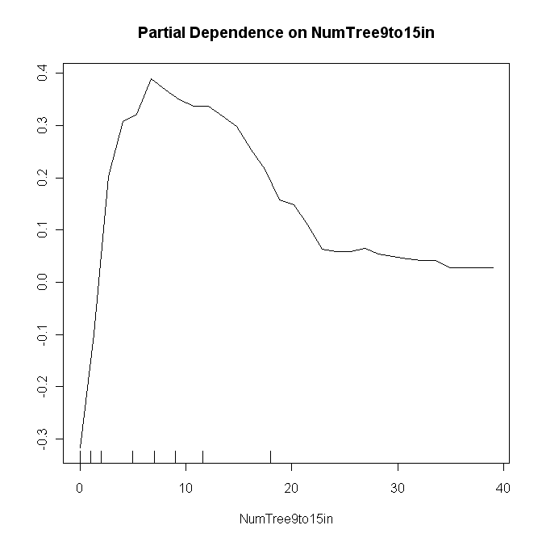
Tree-based Methods for Classification & Regression
Example: Cavity nesting birds, Random Forests, partial dependence plot for NumTree9to15in.
Notes:
On the other hand, this plot shows that the probability of finding a nest increases with the number of trees 9—15in in diameter (up to about 8 or 9). That makes sense: trees of this size are large enough to have cavities to nest in.

Slide 22
Tree-based Methods for Classification & Regression
Cavity Nesting Birds Example
Are the three species similar in the associations of their nest sites with the predictor variables?
Can do separate analyses for each species and look at:
Classification accuracies.
Identification of most important variables.
Partial dependence plots for most important variables.
Can also look graphical representations of proximities and see if the different species have identifiably different sites.
Notes:
We have some questions about the species given the data that was collected.

Slide 23
Tree-based Methods for Classification & Regression
Multidimensional Scaling
Two dimensional representation of matrix of distances among points.
Metric multidimensional scaling tries to find a spatial representation of the data that preserves, to the greatest extent possible, the distances among the points.
Turns out to be equivalent to principal components analysis on the distance matrix.
Non-metric multidimensional scaling preserves the ranks of the distances to the greatest extent possible.
This is a hard non-linear optimization problem
In Random Forests, metric multidimensional scaling is carried out on the distances calculated as 1 – proximity.

Slide 24
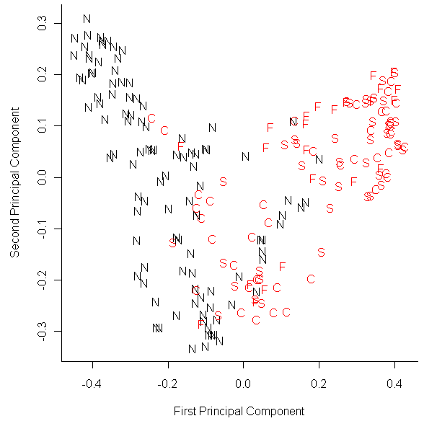
Tree-based Methods for Classification & Regression
Cavity Nesting Birds Example
MDS plot using species labels for plotting characters.
Nest and Non-nest sites are
fairly well separated, but the
three species seem to be very
intermingled.
Notes:
In this plot the Non-nest sites have a black N as a plotting character and the nest sites have plotting characters red C’s, F’s, and S’s for the chickadees, flickers, and sapsuckers, respectively.
One can see that the Non-nest sites are quite well separated from the nest sites but that the nest sites for the three species of birds are thoroughly intermingled. This is more evidence that the three species behave in a similar way with regard to the variables measured in this dataset.

Slide 25
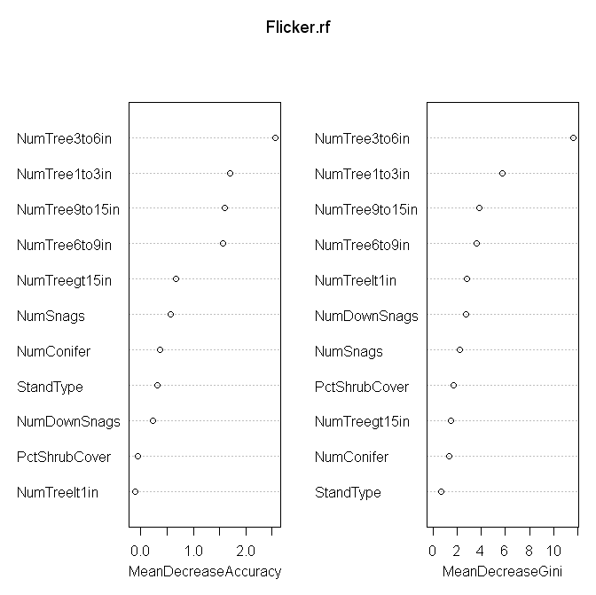
Tree-based Methods for Classification & Regression
Variable Importance for Northern Flicker
Notes:
Next, I thought that I would fit Random Forests to each species separately and to identify the most important variables. Again, looking at the left panel we see that for the northern flickers NumTree3to6in, NumTree1to3in, and NumTree9to15 are the three most important variables with NumTree6to9in a close fourth.

Slide 26
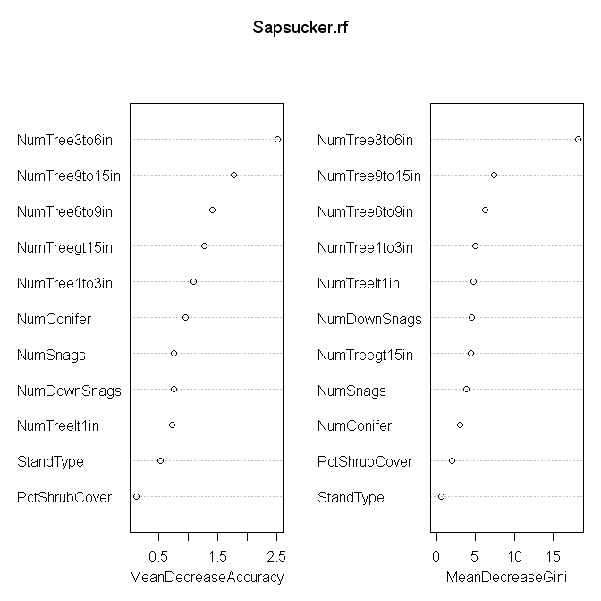
Tree-based Methods for Classification & Regression
Variable Importance for Red-naped Sapsucker
Notes:
For the sapsuckers NumTree3to6in, NumTree9to15in, and NumTree6to9in are the most important variables.

Slide 27
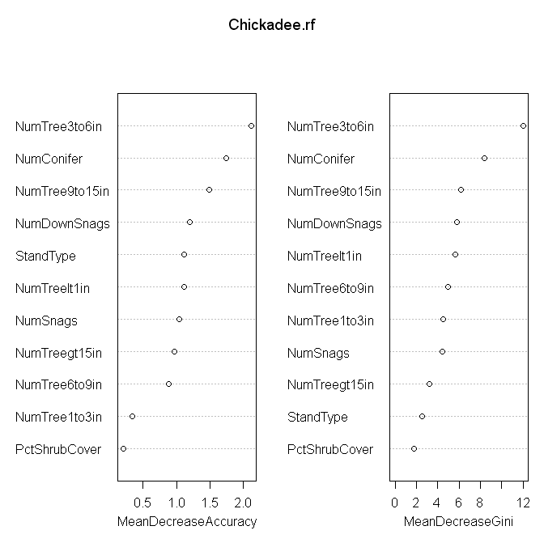
Tree-based Methods for Classification & Regression
Variable Importance for Mountain Chickadee
Notes:
For the chickadees NumTree3to6in, NumConifer, and NumTree9to15in are the three most important variables.
For all three species of cavity nesting bird NumTree3to6in and NumTree9to15in were among the three most important variables.

Slide 28
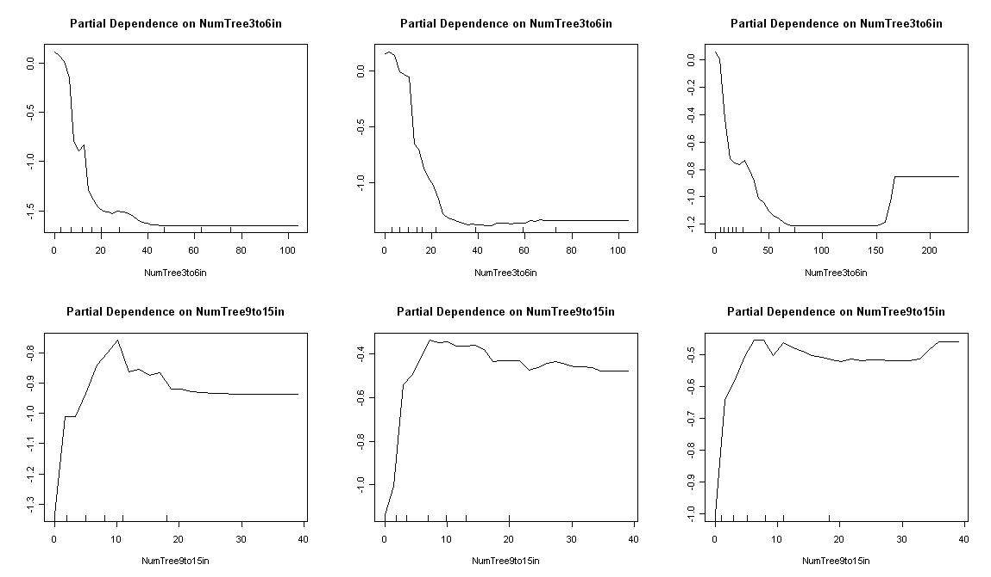
Tree-based Methods for Classification & Regression
Partial Dependence Plots for NumTree3to6in and NumTree9to15in
Notes:
In order to further explore the relationships between the predictor variables NumTree3to6in and NumTree9to15in and the probability of finding a nest I constructed partial dependence plots for these variables and put them side-by-side. It is remarkable how similar the plots are for the three species for each of the two predictor variables. At least with regard to these predictor variables, which are two of the most important variables, the three species of cavity nesting bird are behaving in the same way.

Slide 29
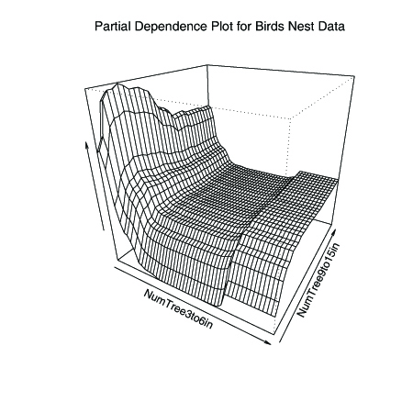
Tree-based Methods for Classification & Regression
Bivariate Partial Dependence Plot for NumTree3to6in and NumTree9to15in
Traces in both coordinate dimensions appear to be parallel suggesting that there is NO interaction between these two predictor variables.
Notes:
We are often interested in interaction among predictor variables and tree-based methods are good at characterizing mathematically, but then we would still like to visualize the interactions in some way. Professor Adele Cutler wrote an R function to generate a partial dependence plot for two predictor variables and I applied it to the variables NumTree3to6in and NumTree9to15in. Holding one of the variables constant and looking at the vale of the logit of the probability for all the vales of the other variable maps out a curve or trace. If the traces are all parallel to each other, that indicated no interaction between the two variables, and that is what we observe here. The traces in both directions are remarkably parallel indicating a complete lack of an interaction between these two variables.

Slide 30

Tree-based Methods for Classification & Regression
Example: Lichen air quality data, $tree with cp=0.059$, crossvalidation accuracies
$$PCC=82.26\%$$
$$Specificity=90.96\%$$
$$Sensitivity=51.87\%$$
$$κ=0.4553$$
$$AUC=0.7777$$
Actual Class | Predicted Class |  | Total
 | Absence | Presence
 | 0 | 1
Absence, 0 | 594 | 59 | 653
Presence, 1 | 90 | 97 | 187
Total | 684 | 156 | 840
Notes:
The next example is a familiar one—the analyses for the lichen species Lobaria oregana. O begin I present the table of accuracies that we saw before for the pruned tree with 4 terminal nodes. The overall (cross-validated!) percent correct for this tree is a little over 82%.

Slide 31

Tree-based Methods for Classification & Regression
Example: Lichen air quality data, Random Forests, out-of-bag accuracies
$$PCC=84.05\%$$
$$Specificity=93.42\%$$
$$Sensitivity=51.34\%$$
$$κ=0.4926$$
$$AUC=0.8869$$
Actual Class | Predicted Class |  | Total
 | Absence | Presence
 | 0 | 1
Absence, 0 | 610 | 43 | 653
Presence, 1 | 91 | 96 | 187
Total | 701 | 139 | 840
Notes:
For Random Forests the out-of-bag classification accuracy (which is equivalent to cross-validated estimates for other procedures) is about 84%, less than 2% better than the pruned classification tree.

Slide 32

Tree-based Methods for Classification & Regression
Example: Lichen air quality data, tree with $cp=0.059$, pilot data evaluation
$$PCC=74.33\%$$
$$Specificity=75.91\%$$
$$Sensitivity=70.00\%$$
$$κ=0.4116$$
$$AUC=0.7458$$
Actual Class | Predicted Class |  | Total
 | Absence | Presence
 | 0 | 1
Absence, 0 | 167 | 53 | 220
Presence, 1 | 24 | 56 | 80
Total | 191 | 109 | 300
Notes:
Predicting presences of Lobaria oregana for the Pilot Random Grid data we get an overall accuracy of a little over 74% …

Slide 33

Tree-based Methods for Classification & Regression
Example: Lichen air quality data, Random Forests, pilot data evaluation
$$PCC=82.67\%$$
$$Specificity=90.91\%$$
$$Sensitivity=60.00\%$$
$$κ=0.5346$$
$$AUC=0.8686$$
Actual Class | Predicted Class |  | Total
 | Absence | Presence
 | 0 | 1
Absence, 0 | 200 | 20 | 220
Presence, 1 | 32 | 48 | 80
Total | 232 | 68 | 300
Notes:
… whereas for Random Forests we get a PCC of nearly 83%. The 8%+ difference in accuracies is probably of practical significance (whereas a difference of 1%—2% might not be). In terms of accuracy in predicting for the Pilot Random Grid data, Random Forests has been the best classifier we have tried so far.

Slide 34
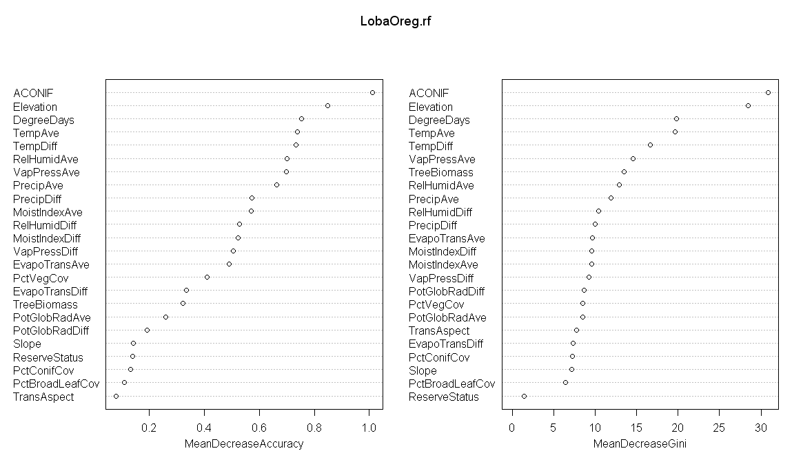
Tree-based Methods for Classification & Regression
Variable Importance Plot for Lobaria oregana
Notes:
I obtained the variable importance values for the lichen data. Again, we are concerned with the left hand plot. The most important variables (in order) are ACONIF (the average age of the dominant conifer at the site), Elevation, DegreeDays, TempAve and TempDiff. Next are RelHumidAve (average relative humidity), VapPressAve (average vapor pressure) and PrecipAve. The 9th and 10th most important variables are PrecipDiff and MoistIndexAve. Just as with logistic regression, classification accuracy can slightly improve with Random Forests when unnecessary variables are removed. There are no rules, nor even any rules of thumb, for how many variables to retain. I usually choose a number where I see a “break” in the variable importances, then refit and see if the out-of-bag error changes. If it does, I may add more variables back in to the classification; if the error rate stays about the same I may try removing a few more variables. In this example I might start with the 8 most important variables and, if possible, removing a few more.

Slide 35
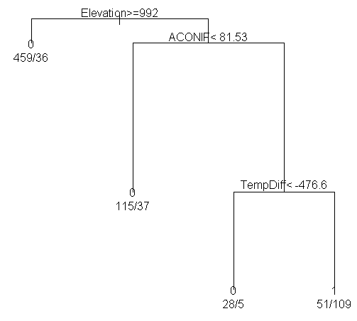
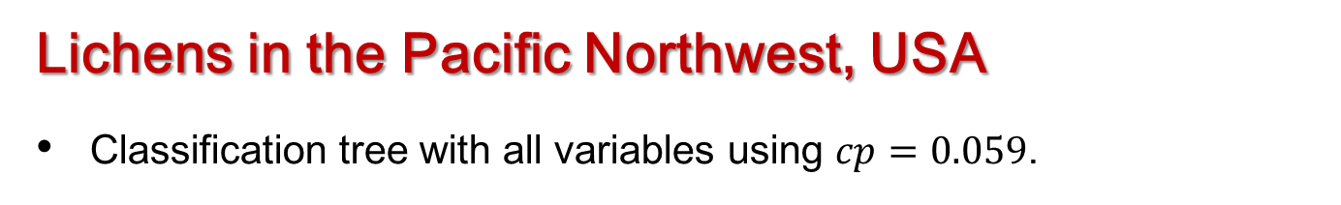
Tree-based Methods for Classification & Regression
Lichens in the Pacific Northwest, USA
Classification tree with all variables using $cp=0.059$.
Gini = 145.3702
Gini = 118.292
Gini = 108.039
Gini = 100.361
Notes:
The next thing I want to do is to visualize the effects of the more important variables with partial dependence plots. As a reference I am showing you the classification tree that we first fit to the lichen data. Trees are very abrupt in their changes: below some threshold they have one value, above the threshold another value.

Slide 36
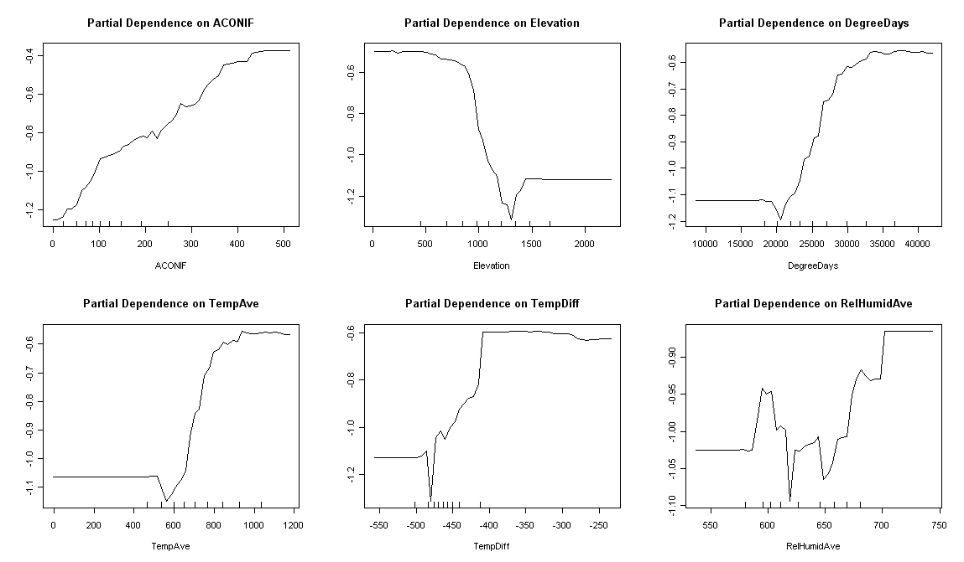
Tree-based Methods for Classification & Regression
Partial dependence plots for Lobaria oregana
Notes:
Here are the partial dependence plots for six variables. Let’s start with the plot for Elevation. The probability of finding Lobaria oregana is fairly constant until an Elevation of about 1,000m and at that point it drops precipitously. For TempAve, TempDiff, and DegreeDays we see almost the opposite. The (logit of) the probability of finding Lobaria oregana starts low, then rises rapidly in the middle of the plot before flattening out. For all four of these variables the tree model of just two values is a very good approximation to what we see in the partial dependence plots. The variable that stands out as being different in nature is ACONIF. For this variable, the probability of Lobaria oregana being present rises almost linearly (on the logit scale) with increasing values of ACONIF. For this variable logistic regression is a better model than a classification tree.

Slide 37
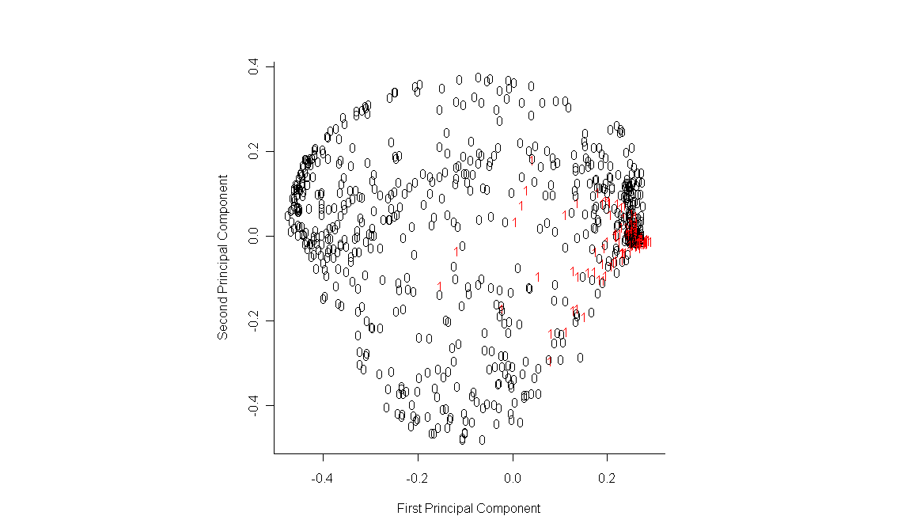
Tree-based Methods for Classification & Regression
Multidimensional scaling plot for Lobaria oregana
Notes:
For the cavity nesting birds’ data I obtained the MDS plot and it was quite revealing: the Non-nest sites were fairly well separated from the nest sites but the nest sites for the three bird species were all intermingled.
I constructed the same plot for the lichen dataset and it is much less informative. The sites where Lobaria oregana is present are concentrated on the right of the plot but are intermingled with sites at which the lichen is not present.

